Slide 1




Unit 7 Grade 5
Wildlife
الحياة البرية
Seth and his sister Emma visit the zoo
سيث واخته يزورون حديقة الحيوان

Slide 2
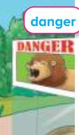
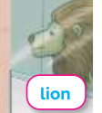
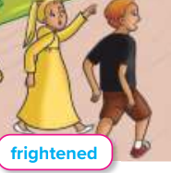
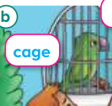
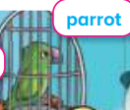

Danger خطر
Lion أسد
Frightenedخائف
Cage قفص
Parrotبغبغاء
Pandaباندا

Slide 3
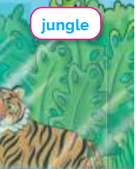
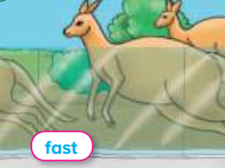
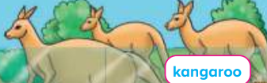

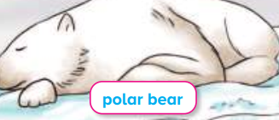
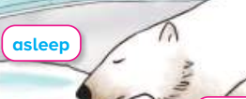
jungle غابة
Fastسريع
Kangarooكنغر
Asleepنائم
Polar bearدب قطبي
Slowlyببطء

Slide 4
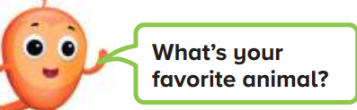
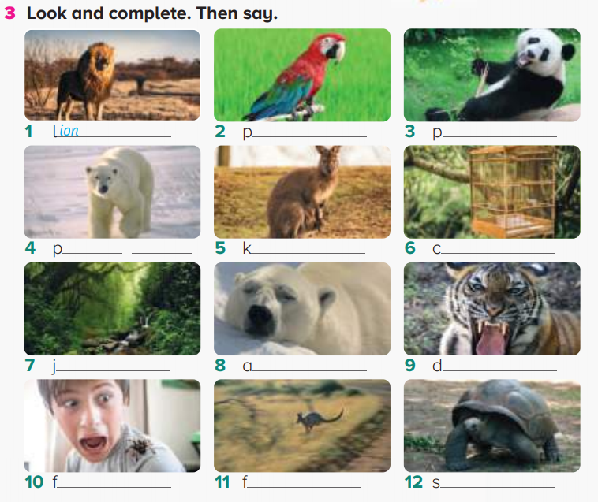
ما حيوانك المفضل؟
arrot
anda
olar bear
angaroo
age
ungle
sleep
anger
rightened
ast
lowly

Slide 5
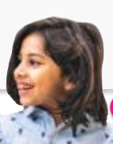
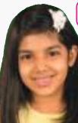
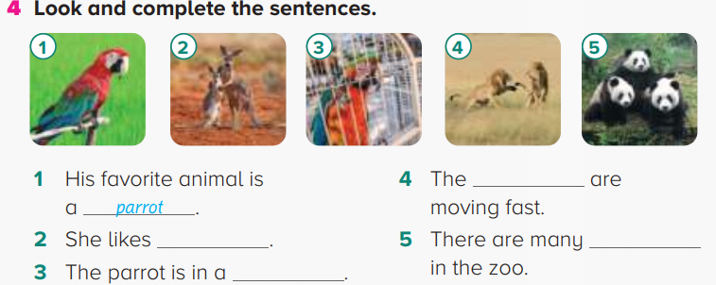
Look at the picture. Complete the sentences.
Can I see your zoo? هل يمكنني رؤية حديقة حيوانك
Sur. Here are the lions. Here is the polar bear. It is in a cage.
lions
kangaroos
pandas
cage

Slide 6
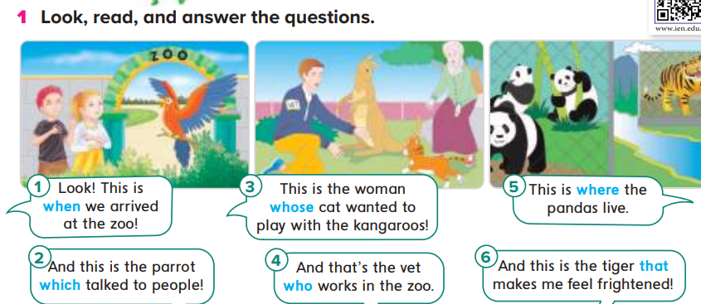
When عندما(الوقت)
Whichالذي-التي لغير العاقل
Whose الذي يمتلك
Whoالذي-التي للعاقل
Whereحيث(للمكان)
That تحل محل who-which-where-when

Slide 7
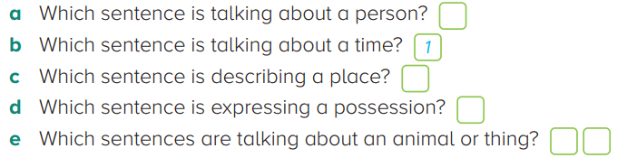

Number the following sentences:
4
5
3
2
6

Slide 8
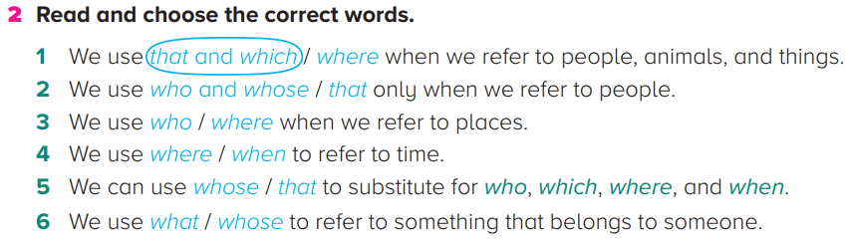
Grammar

Slide 9
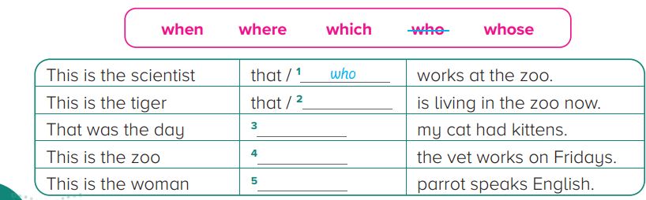
Complete the following chart
which
when
where
whose

Slide 10
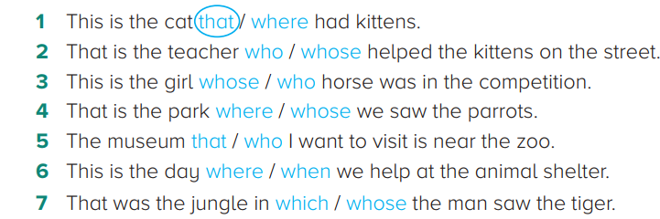
Read and choose the correct words

Slide 11
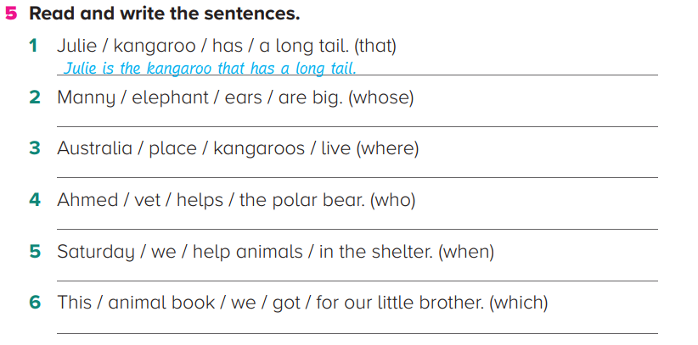
Read and write the sentences
Manny is the elephant whose ears are big
Australia is the place where kangaroos live
Ahmed is the vet who helps the polar bear
Saturday is when we help animals in the shelter
This animal book which we got for our little brother

Slide 12
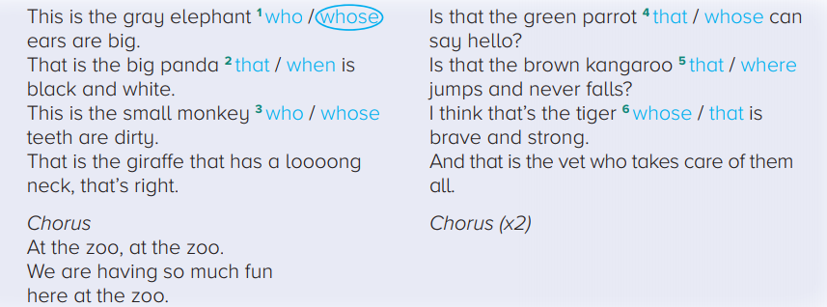
Read and choose the answer

Slide 13

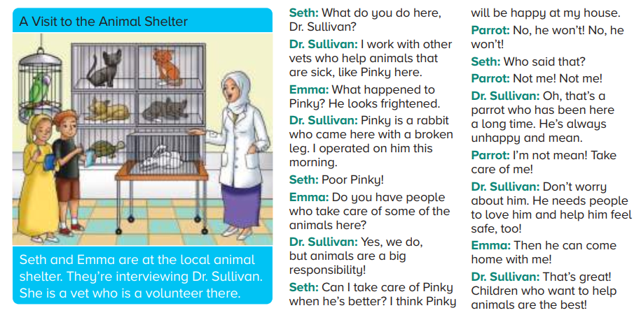
Reading
Animal shelterملجأ الحيوانات
Interviewيقابل
Volunteerمتطوع
What happened?ماذا حدث؟
Operateيجري عملية
Take care ofيعتني ب
Responsibilityمسئولية
Who?من؟
Meanوضيع
Safeأمن

Slide 14
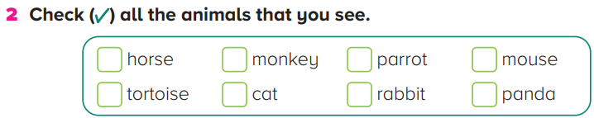
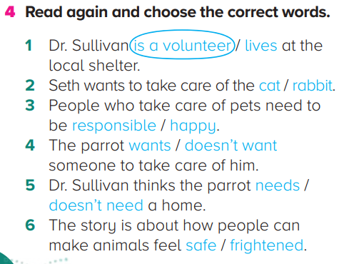
√
√
√
√

Slide 15

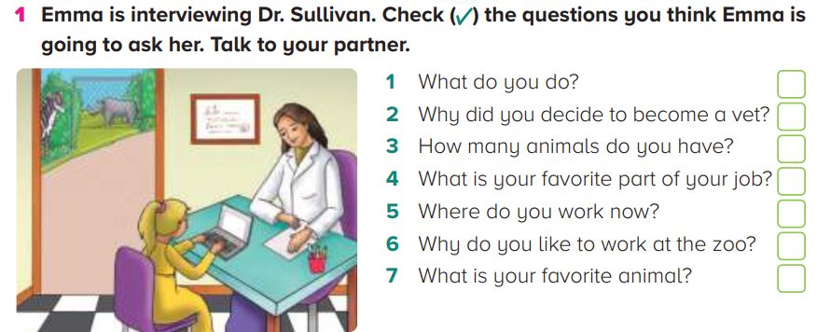
Check the questions

Slide 16

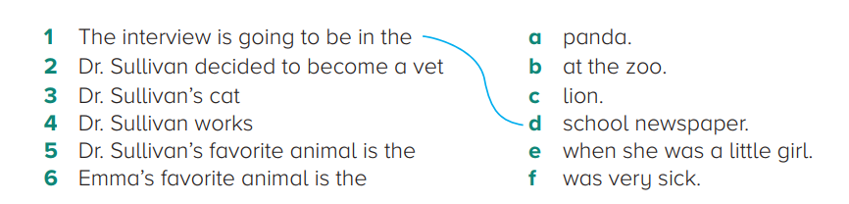
Match the following

Slide 17

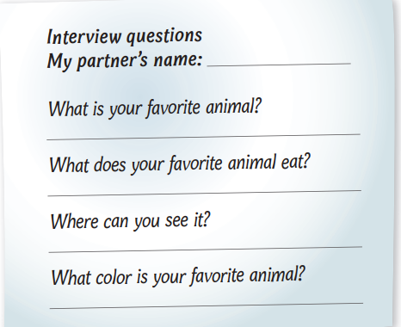
Practice time

Slide 18
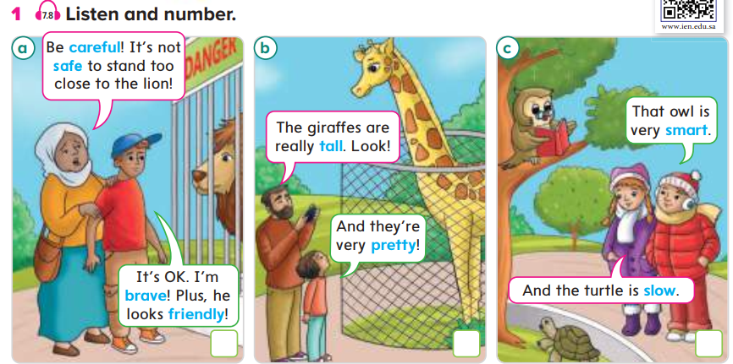
Read the following
Carefulحريص
Safeأمن
Braveشجاع
Friendlyودود
Tallطويل
Prettyجميل
Smartذكي
Slowبطئ

Slide 19
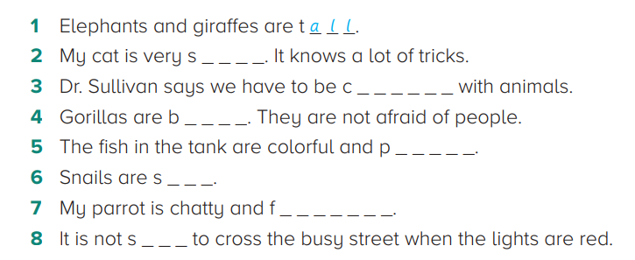
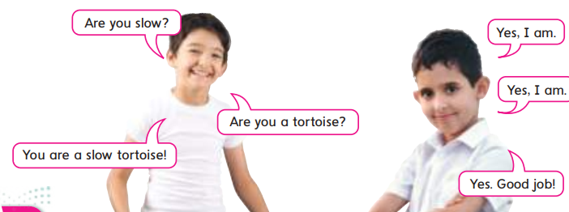
Read and complete the words
mart
areful
rave
retty
low
riendly
afe

Slide 20
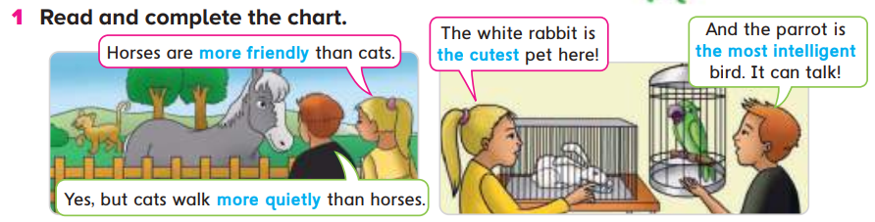

Slide 21

Grammar
Whenever we form comparative(صفات المقارنة) we usually add “er” to the short adjective.
For example: Taller than – Shorter than – faster than
We form Comparative, we usually add “more” before the adjective
For example: more beautiful than – more expensive than
We form a superlative (صفات التفضيل)we just simple add “est” and “the” to the short adjective.
For example: The Tallest – The Shortest – The fastest
We form a superlative (صفات التفضيل)we just simple add “the most” before the long adjective.
For example: The most beautiful – The most expensive

Slide 22
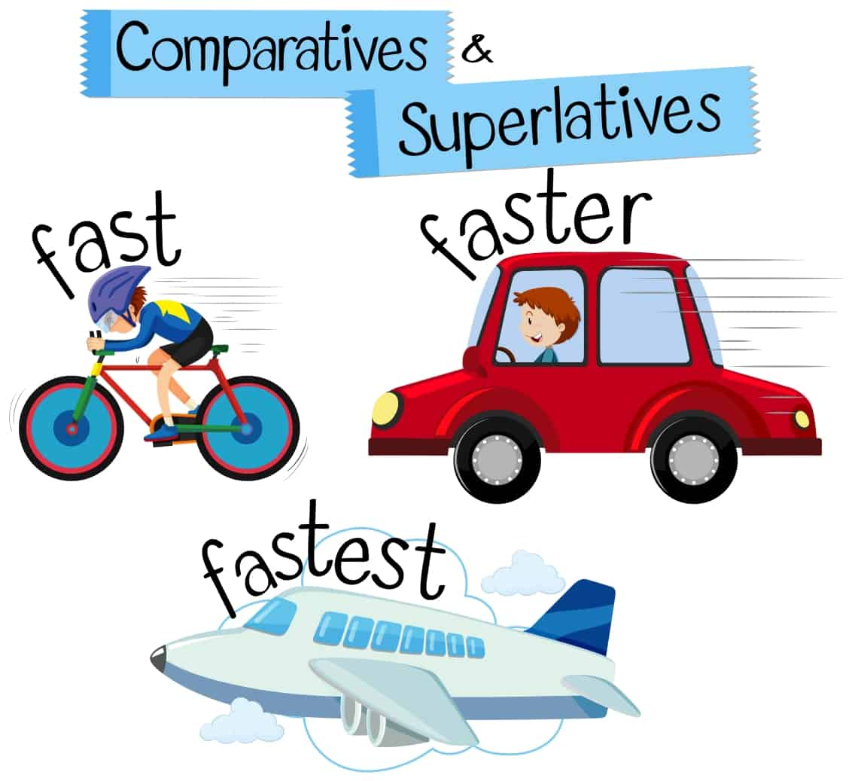
Grammar
A car is faster than a bicycle
The airplane is the fastest

Slide 23
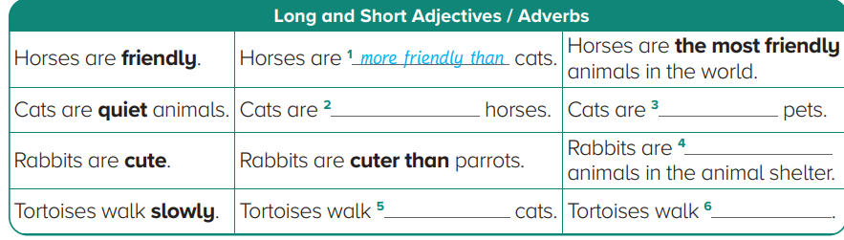
Complete the following chart
quieter than
the quietest
the cutest
slower than
the slowest

Slide 24
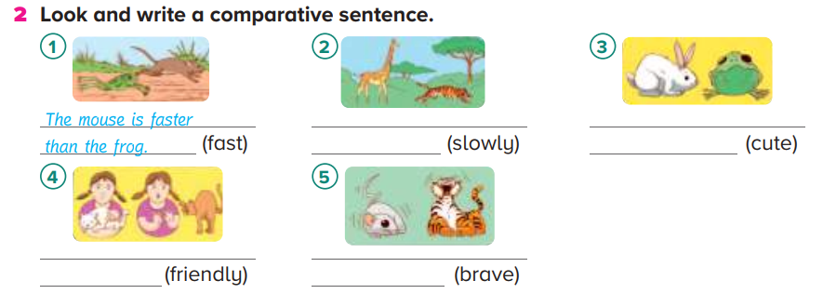
Look and write a comparative sentence
The giraffe is walking more slowly than the lion
The rabbit is cuter than the frog
The white cat is more friendly than the brown cat
The tiger is braver than the mouse

Slide 25
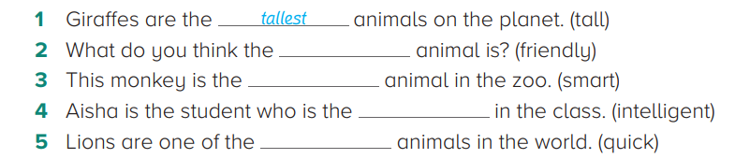
Complete with the superlative form
most friendly
smartest
most intelligent
quickest

Slide 26
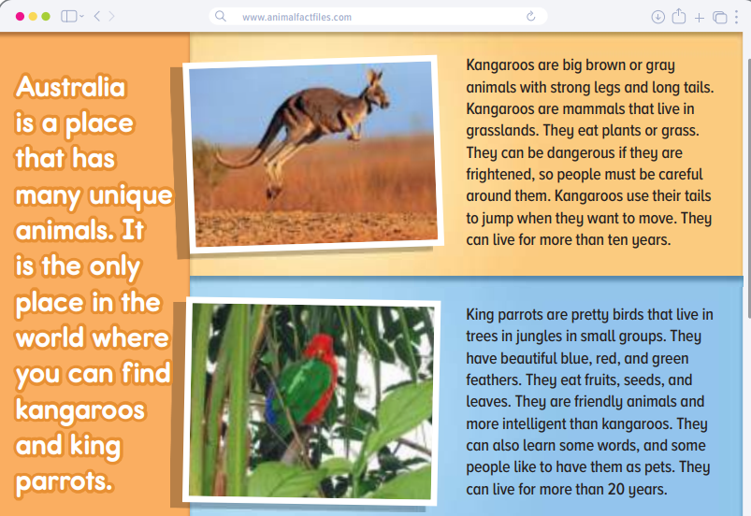
Reading
Uniqueمميز
Findيجد
Tailذيل
Mammalsثدييات
Grasslandsأراضي عشبية
Dangerousخطير
Prettyجميل
Feathersريش
Seedsبذور
Leavesأوراق شجر

Slide 27
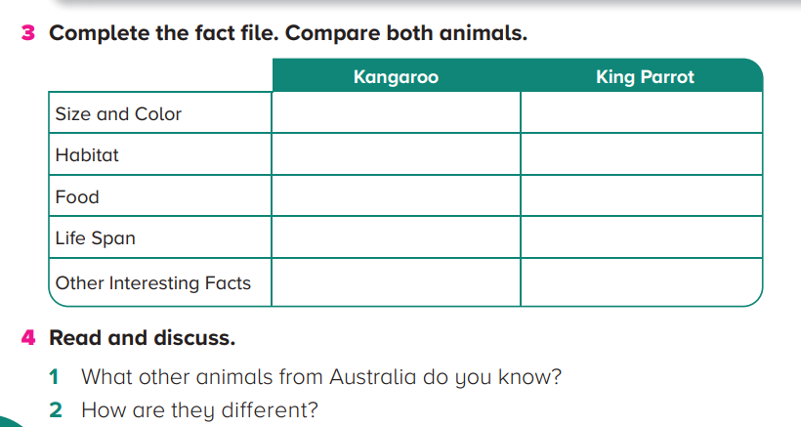
Big, brown
Blue,red and green
grasslands
tress in the jungle
grass and plants
fruits, seeds and leaves
More than 10 years
More than 20 years
use their tail to jump
Friendly, people like them as pets

Slide 28
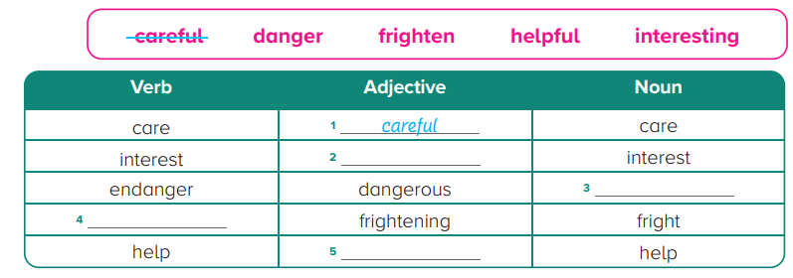
Complete the chart
interesting
danger
frighten
helpful

Slide 29
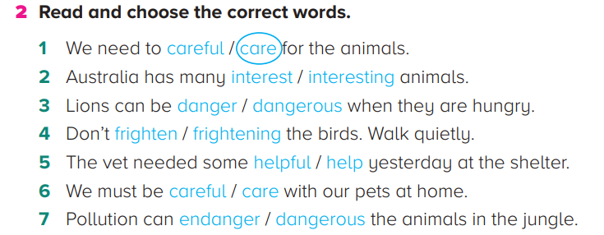
Read and choose the correct words

Slide 30
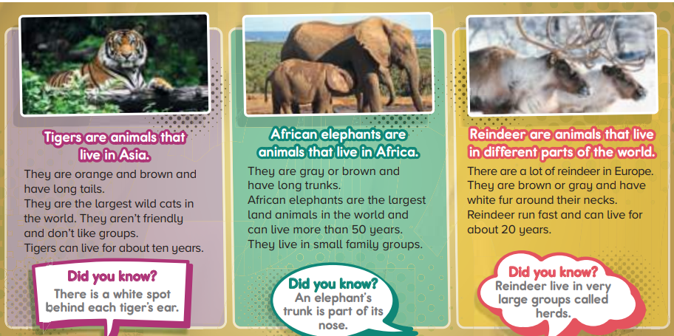
Reading
Asia اسيا
Tailsذيول
Spotبقعة
Trunkخرطوم الفيل
Reindeerرنة
Furفرو
Necksأعناق
Herdsأسراب

Slide 31
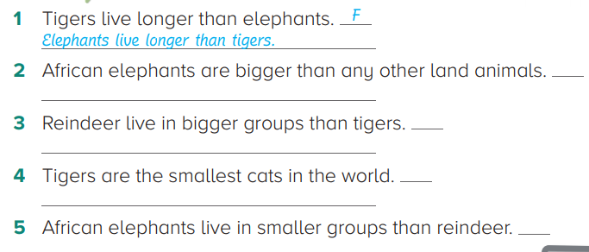
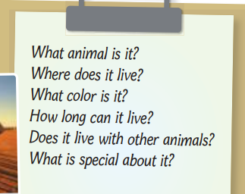
Put “T” or “F” and correct the false ones
T
T
F
Tigers are not the smallest cats in the world
T

Slide 32


